Slide 1

Computing Specifications for Missing Code
Shuangxiang Kan,
Program Analysis Group
University of Technology Sydney (UTS)
12/8/2022
1 / 29
Notes:
hello, everyone, today, I’m going to talk about how to compute specifications(or summaries) for missing code.

Slide 2
Introduction
﻿To guarantee soundness, static analysis often assume that all program source code can be analyzed. This assumption has become tenuous as programs increasingly depend on large libraries and frameworks that are prohibitively difficult to analyze. ﻿In any large software system, there are inevitably parts that are missing and cannot be handled soundly.
Missing code (Opaque code), which is executable but whose source is unavailable or hard to process.
2 / 29
Notes:
﻿To guarantee soundness, static analyses often assume that all program source code can be analyzed. However, this assumption is somewhat flawed, because, nowdays, programs increasingly depend on large libraries and frameworks whose source code is missing or difficult to analyze. ﻿Without full source code, static analysis is difficult to give sound results
Missing code (Opaque code), which is executable but whose source is unavailable or hard to process.

Slide 3
void main() // program
{
string str = mkStr();
List list = new List();
list.add(str);
Object data = list.get(0);
if (randBool())
{
Object dataCopy = data;
sendHttp(dataCopy);
}
}
﻿Whether the program leaks the return value of mkStr to the Internet via a call to sendHttp ?
str dataCopy
3 / 29
Notes:
Here is an example, in the code on the right，The main() function calls many library functions, such as mkStr(), list.get(), list.add(), etc.，and we would like to know Whether this program leaks the return value of mkStr to the Internet via a call to sendHttp ?

Slide 4
string mkStr()
{
......
......
}
void main() // program
{
string str = mkStr();
List list = new List();
list.add(str);
Object data = list.get(0);
if (randBool())
{
Object dataCopy = data;
sendHttp(dataCopy);
}
}
void add(List list)
{
......
......
}
﻿Whether the program leaks the return value of mkStr to the Internet via a call to sendHttp ?
Object get(int index)
{
......
......
}
void sendHttp(Object dataCopy)
{
......
......
}
str dataCopy
4 / 29
Notes:
If source code of these called functions is available, the static analysis will know the control flow and value flow of main function()，then we know the variables “str” and “datacopy” are aliased.

Slide 5
string mkStr()
{
......
......
}
void main() // program
{
string str = mkStr();
List list = new List();
list.add(str);
Object data = list.get(0);
if (randBool())
{
Object dataCopy = data;
sendHttp(dataCopy);
}
}
void add(List list)
{
......
......
}
﻿Whether the program leaks the return value of mkStr to the Internet via a call to sendHttp ?
Object get(int index)
{
......
......
}
void sendHttp(Object dataCopy)
{
......
......
}
str alised! dataCopy
5 / 29
Notes:
If source code of these called functions is available, the static analysis will know the control flow and value flow of main function()，then we know the variables “str” and “datacopy” are aliased.

Slide 6
void main() // program
{
string str = mkStr();
List list = new List();
list.add(str);
Object data = list.get(0);
if (randBool())
{
Object dataCopy = data;
sendHttp(dataCopy);
}
}
No source code
﻿Whether the program leaks the return value of mkStr to the Internet via a call to sendHttp ?
str alised? dataCopy
6 / 29
Notes:
However, if the source code of these functions is missing, we will not know the relationship between the variable str and datacopy.

Slide 7
Solutions
﻿Two possible approaches are to ﻿make either unsound or overly conservative assumptions on what those missing code might do.
optimistic assumptions ：no-ops in missing code. ﻿﻿Unsound and yields many false negatives
pessimistic assumptions：do anything in missing code. ﻿﻿sound but grossly imprecise, yielding many false positives.
7 / 29
Notes:
Two common ways to handle this problem is to make either unsound or conservative assumptions on what those missing code might do. The first approaches is to make optimistic assumptions, it assumes that there are no operations in missing code. However, this assumption will be unsound and yields many false negatives. The second assumptions is to make pessimistic assumptions, it assumes that missing code can do anything, but this assumption is grossly imprecise, and can yield many false positives.

Slide 8
Solutions
﻿The third approach to address these problems is to manually write ﻿specifications (also known as summaries, models, annotations, or stubs) ﻿that summarize missing code. ﻿This approach is very flexible, since specifications can be used to model arbitrary missing code.
Limitations:
﻿Handwritten specifications can be error-prone, and must be updated whenever the missing code changes.
﻿﻿Specifications are costly to write, since many thousands of specifications may be needed
8 / 29
Notes:
The third approach to address these problems is to manually write ﻿specifications (also known as summaries, models, annotations, or stubs) ﻿that summarize missing code. ﻿This approach is very flexible, since specifications can be used to model arbitrary missing code. Although this third approach is very useful, it also has obvious Limitations: The first one is ﻿Handwritten specifications can be error-prone, The person who writes the specification must be very familiar with missing code and must be updated whenever the missing code changes. The second one is ﻿﻿Specifications are costly to write, since hundreds or thousands of specifications may be needed in a library or in a framework.

Slide 9
Introduction
﻿The third approach is to manually write ﻿specifications (also known as summaries, models, annotations, or stubs) ﻿that summarize the behaviors of the missing code. ﻿This approach is very flexible, since specifications can be used to model arbitrary missing code.
Limitations:
﻿Handwritten specifications can be error-prone, and must be updated whenever the missing code changes.
﻿﻿Specifications are costly to write, since many thousands of specifications may be needed
Specifications inference automation
9 / 29
Notes:
So today my talk mainly focuses on how to automatically infer specifications.

Slide 10
How to automatically infer specifications without source code?
Combining of ﻿dynamic points-to analysis and static analysis.
﻿Inferring specifications via the client-observable behavior of software components.
﻿Intercepting memory accesses from the missing code to client objects and uses this information to infer specifications.
10 / 29

Slide 11
Combining of ﻿dynamic points-to analysis and static analysis.
Procedures:
Given a program, the system first runs the static points-to analysis that optimistically assumes missing code is empty.
2. The system instruments the program to detect counterexamples to the optimistic assumptions – i.e., missing points-to edges that occur during an execution but are missing from the (optimistic) static analysis.
﻿3. Recomputing the static analysis to account for this new information
11 / 29

Slide 12
Combining of ﻿dynamic points-to analysis and static analysis.
1. void main() // program
2. {
3. string str = mkStr();
4. List list = new List();
5. list.add(str);
6. Object data = list.get(0);
7. if (randBool())
8. {
9. Object dataCopy = data;
10. sendHttp(dataCopy);
11. }
12. }
Static analysis:
str → {}
12 / 29
Notes:
Here is an example, first, When the static analysis is completed, variable str points to an empty set

Slide 13

Combining of ﻿dynamic points-to analysis and static analysis.
1. void main() // program
2. {
3. string str = mkStr();
4. List list = new List();
5. list.add(str);
6. Object data = list.get(0);
7. if (randBool())
8. {
9. Object dataCopy = data;
10. sendHttp(dataCopy);
11. }
12. }
Static analysis:
str → {}
Dynamic points-to analysis:
str → { } concrete object
13 / 29
Notes:
Then the dynamic points-to analysis starts, During dynamic point-to analysis execution, variable str points to an concrete object Strobj, it represents the dynamic analysis finds a counterexample and reports to the system.

Slide 14

Combining of ﻿dynamic points-to analysis and static analysis.
1. void main() // program
2. {
3. string str = mkStr();
4. List list = new List();
5. list.add(str);
6. Object data = list.get(0);
7. if (randBool())
8. {
9. Object dataCopy = data;
10. sendHttp(dataCopy);
11. }
12. }
Static analysis:
str → {}
Dynamic points-to analysis:
str → { } concrete object
Static analysis:
str → { } abstract object
14 / 29
Notes:
Then the static anslysis updates its points-to set, and at this time str points to an abstract object Strobj. This process continues until no new counterexample appears

Slide 15
Combining of ﻿dynamic points-to analysis and static analysis.
1. void main() // program
2. {
3. string str = mkStr();
4. List list = new List();
5. list.add(str);
6. Object data = list.get(0);
7. if (randBool())
8. {
9. Object dataCopy = data;
10. sendHttp(dataCopy);
11. }
12. }
Static analysis:
str → {}
Dynamic points-to analysis:
str → { } concrete object
Static analysis:
str → { } abstract object
No new counterexample
15 / 29
Notes:
Then the static anslysis updates its points-to set, and at this time str points to an abstract object Strobj. This process continues until no new counterexample appears

Slide 16

Combining of ﻿dynamic points-to analysis and static analysis.
class List // library
{
Object f;
void add(Object ob)
{
f = ob;
}
Object get(int i)
{
return f;
}
}
data → ${str}_{obj}$,
specification
16 / 29
Notes:
Finally, when the process is finished, according to the counterexample, the system can generate correspoding specifications.

Slide 17
﻿Inferring specifications via the client-observable behavior of software components
APP
Initial hypothesis
Initial inputs
execute
﻿The approach provides different inputs to the component, and observes the resulting outputs to infer a model
of the component’s behavior as a program in a domain-specific language.
Outputs
Refine hypothesis
new inputs
execute
New outputs
Refine hypothesis
new inputs
execute
New outputs
…
17 / 29
Notes:
The second approach is also about runtime performance of missing code. But it does not detect points-to set about variables, it captures the behaviours of different input and output of missing code, and use domain-specific language to model the behaviour of the missing code, and finally transform the domain-specific language to the specifications.

Slide 18
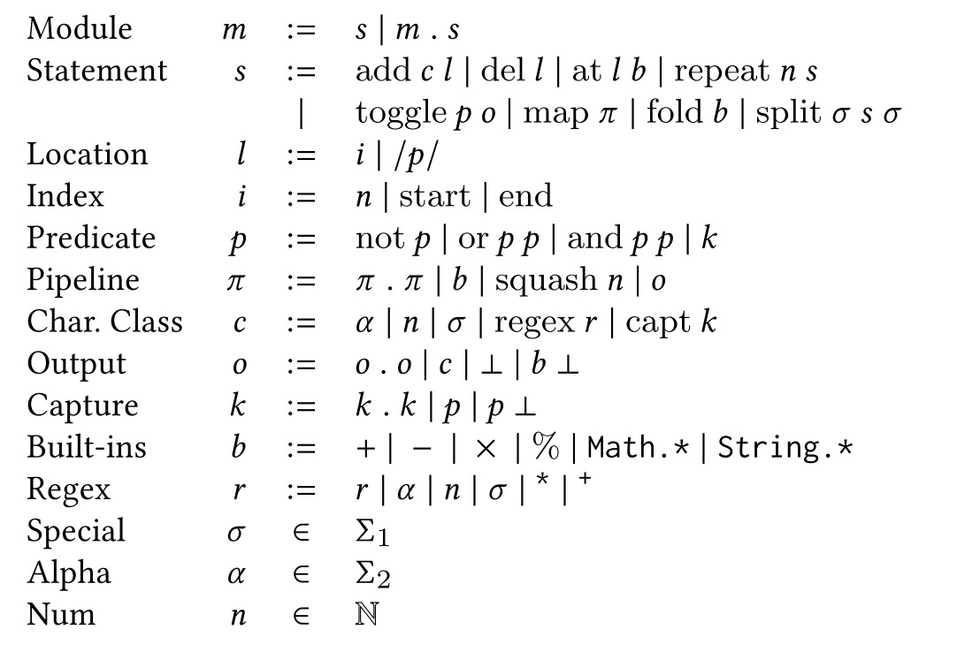
﻿Inferring specifications via the client-observable behavior of software components
class String // library
{
Object f;
int length()
{
…;
}
Object get(int i)
{
…;
}
}
Inputs/
outputs
specification
﻿The domain-specific language (DSL) captures the space of inferrable string libraries.
18 / 29
Notes:
﻿Using increasingly sophisticated rounds of exploration, This approach generates inputs, provides these inputs to the component, and observes the resulting outputs to infer a model of the component’s behavior as a program in a domain-specific language.

Slide 19
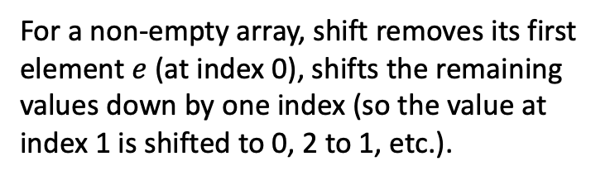
Intercepting memory accesses from the missing code to client objects and uses
this information to infer specifications.
var arr = [ 'a' , 'b' , 'c' , 'd' ];
var x = arr.shift();
// x is 'a' , and arr is now [ 'b' , 'c' , 'd']
﻿For a non-empty array, shift removes its first
element $e$ ﻿(at index 0), shifts the remaining
values down by one index (so the value at
index 1 is shifted to 0, 2 to 1, etc.).
19 / 29

Slide 20
Intercepting memory accesses from the missing code to client objects and uses
this information to infer specifications.
var arr = [ 'a' , 'b' , 'c' , 'd' ];
var x = arr.shift();
// x is 'a' , and arr is now [ 'b' , 'c' , 'd']
read field 'length' of arg0 // 4
read field 0 of arg0 // ' a '
read field 1 of arg0 // ' b '
write 'b' to field 0 of arg0
read field 2 of arg0 // ' c '
write 'c' to field 1 of arg0
read field 3 of arg0 // ' d '
write 'd' to field 2 of arg0
delete field 3 of arg0
write 3 to field 'length' of arg0
return 'a'
﻿For a non-empty array, shift removes its first
element $e$ ﻿(at index 0), shifts the remaining
values down by one index (so the value at
index 1 is shifted to 0, 2 to 1, etc.).
shift() trace
20 / 29
Notes:
﻿The trace contains reads from and writes to the array parameter arg0

Slide 21
Intercepting memory accesses from the missing code to client objects and uses
this information to infer specifications.
read field 'length' of arg0 // 4
read field 0 of arg0 // ' a '
read field 1 of arg0 // ' b '
write 'b' to field 0 of arg0
read field 2 of arg0 // ' c '
write 'c' to field 1 of arg0
read field 3 of arg0 // ' d '
write 'd' to field 2 of arg0
delete field 3 of arg0
write 3 to field 'length' of arg0
return 'a'
read;read;(read;write)*;delete;write;
.
.
.
read;read;read;(write;read)*;write;delete;write;
trace
trace skeleton
21 / 29
Notes:
﻿When we get the execution trace of missing code, next step is to abstract each trace to a trace skeleton, which summarize the ﻿the structure of the computation of the missing code.

Slide 22
Intercepting memory accesses from the missing code to client objects and uses
this information to infer specifications.
read field 'length' of arg0 // 4
read field 0 of arg0 // ' a '
read field 1 of arg0 // ' b '
write 'b' to field 0 of arg0
read field 2 of arg0 // ' c '
write 'c' to field 1 of arg0
read field 3 of arg0 // ' d '
write 'd' to field 2 of arg0
delete field 3 of arg0
write 3 to field 'length' of arg0
return 'a'
read;read;(read;write)*;delete;write;
✔️
.
.
.
read;read;read;(write;read)*;write;delete;write;
trace
trace skeleton
22 / 29
Notes:
﻿When we get the execution trace of missing code, next step is to abstract each trace to a trace skeleton, which summarize the ﻿the structure of the computation of the missing code.

Slide 23
Intercepting memory accesses from the missing code to client objects and uses
this information to infer specifications.
read;read;(read;write)*;delete;write;
trace skeleton
23 / 29
Notes:
When we get the trace skeleten which match the execution traces best, we can use it to generate the specifications.

Slide 24
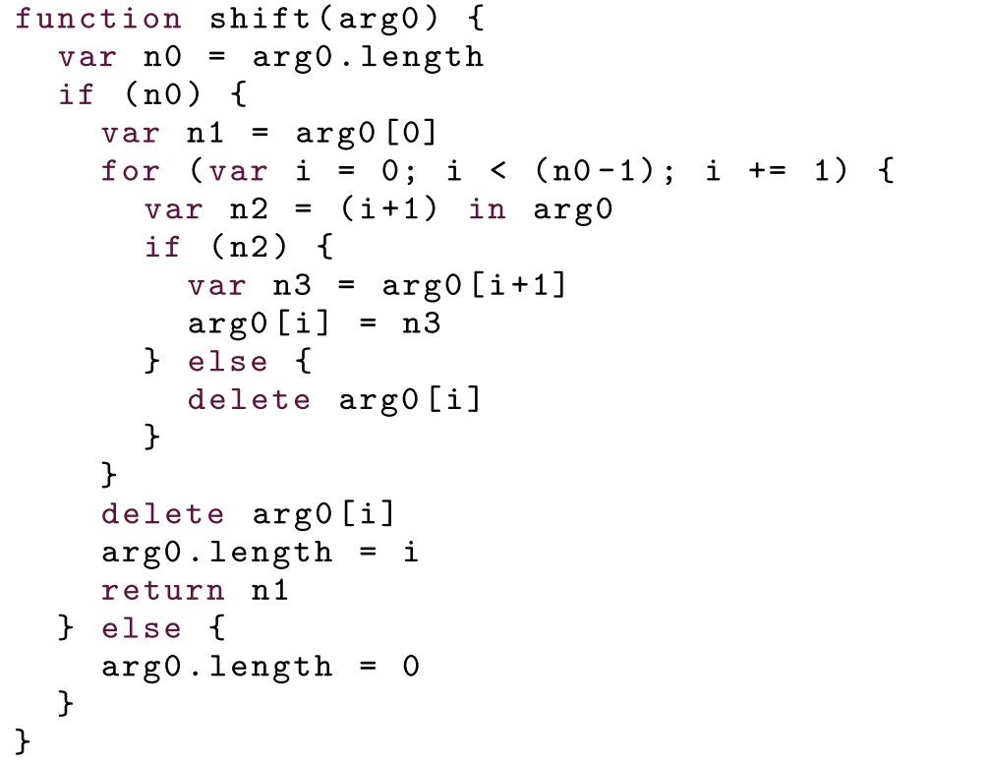
Intercepting memory accesses from the missing code to client objects and uses
this information to infer specifications.
read;read;(read;write)*;delete;write;
trace skeleton
specification
24 / 29

Slide 25
Limitations
Soundness is not guaranteed. If some corner cases are not executed, the behaviors of
missing code will not be inferred.
Complex structures of missing code are difficult to infer, e.g. multiple loops and conditions.
3. Only works with certain types of functions, e.g. string functions or database functions.
25 / 29

Slide 26
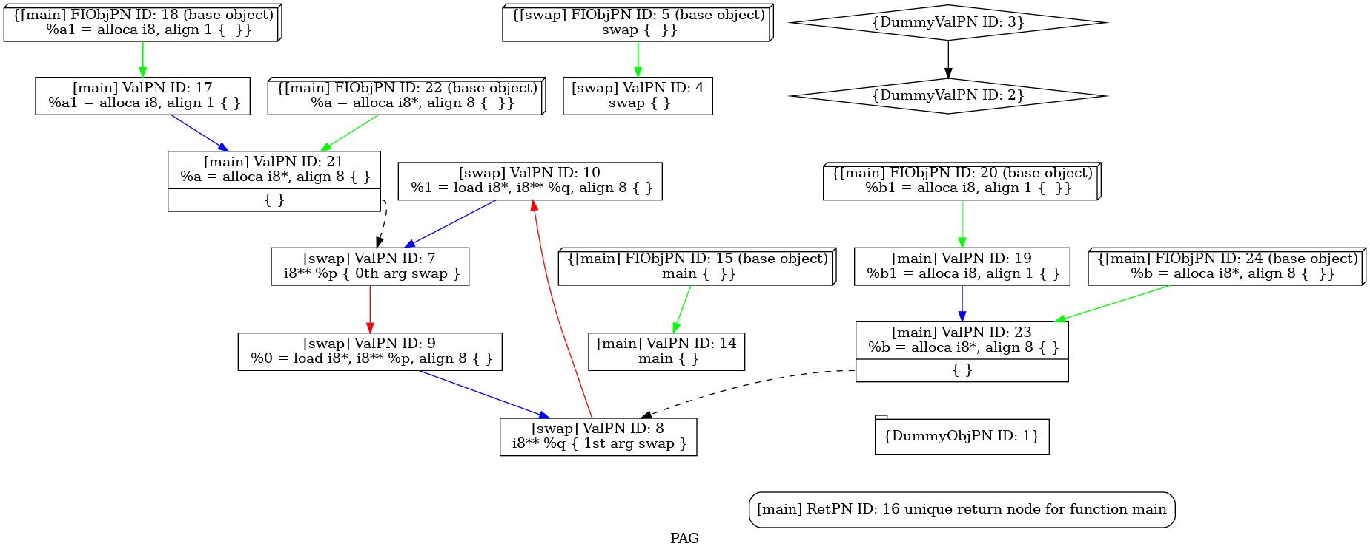
Extern APIs in SVF
26 / 29
Notes:
Before performing any other analysis, such as alias analysis, Taint analysis, we need to construct the PAG of the program.

Slide 27
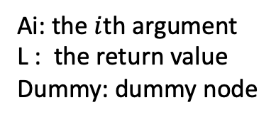
Extern APIs in SVF
"foo": {
"load": {
"src": "A0",
"dst": ”Dummy"
},
"store": {
"src": ”Dummy",
"dst": "A2"
},
"copy": {
"src": "A0",
"dst": ”A1"
},
"addr": {
"src": "L",
"dst": "L"
}
}
; Function Attrs: noinline nounwind optnone ssp uwtable
define i32 @main() #0 {
%1 = alloca i32, align 4
%2 = alloca %struct.s1, align 8
%3 = alloca %struct.s1, align 8
store i32 0, i32* %1, align 4
%4 = bitcast %struct.s1* %2 to i8*
%5 = bitcast %struct.s1* %3 to i8*
%6 = bitcast %struct.s1* %2 to i8*
%7 = call i8* @ foo(i8* %5, i8* %6, i32 16)
ret i32 0
}
declare i8* @ foo(i8*, i8*, i32) #2
Ai: the $i$th argument
L : the return value
Dummy: dummy node
ExtAPI.json
27 / 29

Slide 28
Extern APIs in SVF
read field 'length' of arg0 // 4
read field 0 of arg0 // ' a '
read field 1 of arg0 // ' b '
write 'b' to field 0 of arg0
read field 2 of arg0 // ' c '
write 'c' to field 1 of arg0
read field 3 of arg0 // ' d '
write 'd' to field 2 of arg0
delete field 3 of arg0
write 3 to field 'length' of arg0
return 'a'
addLoadEdge(……)
addStoreEdge(……)
trace
28 / 29
Notes:
What attracts me most is the third method, which I think is more suitable for generating SVF specifications However, the third method is still in the exploratory stage. If this method is really feasible, I will further elaborate this method in the following talk.

Slide 29
Thanks
29 / 29
Notes:
That's all I'm going to talk about today, thank you.

